Slide 1
Fraud Detection from Medicare Claims Data
Harsh Jain

Slide 2
Objective
Background: The US government provides Medicare and Medicaid services to the elderly and other eligible Americans, and some fraudulent providers have taken advantage of the funds.
Finding features that help in distinguishing between fraudulent and non-fraudulent activities
Creating and comparing classifiers
Target Variable: Fraud_Label
Dataset: CMS dataset (years 2012 – 2015)

Slide 3
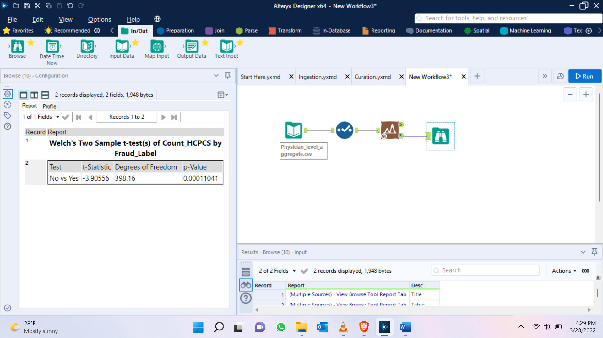
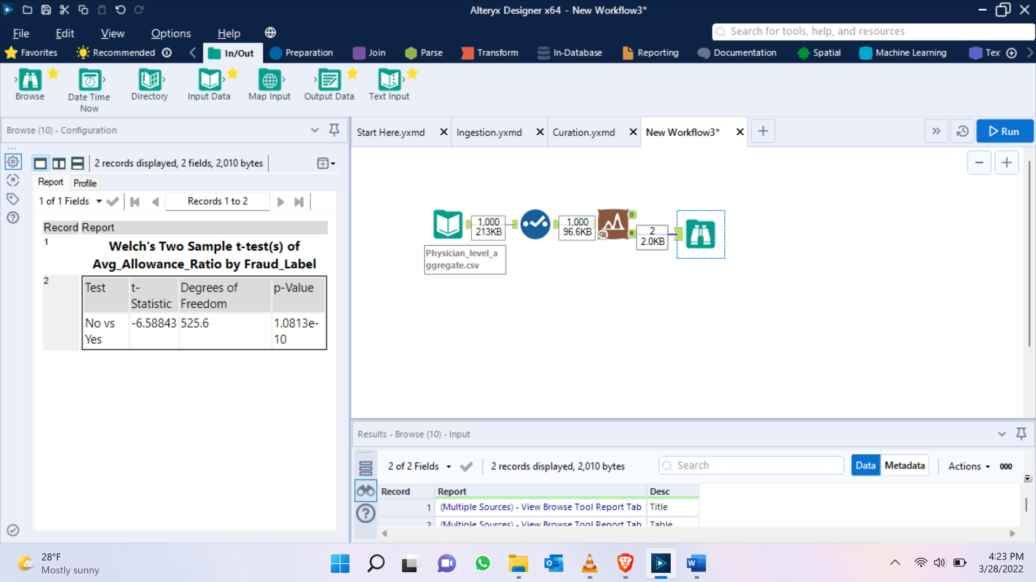
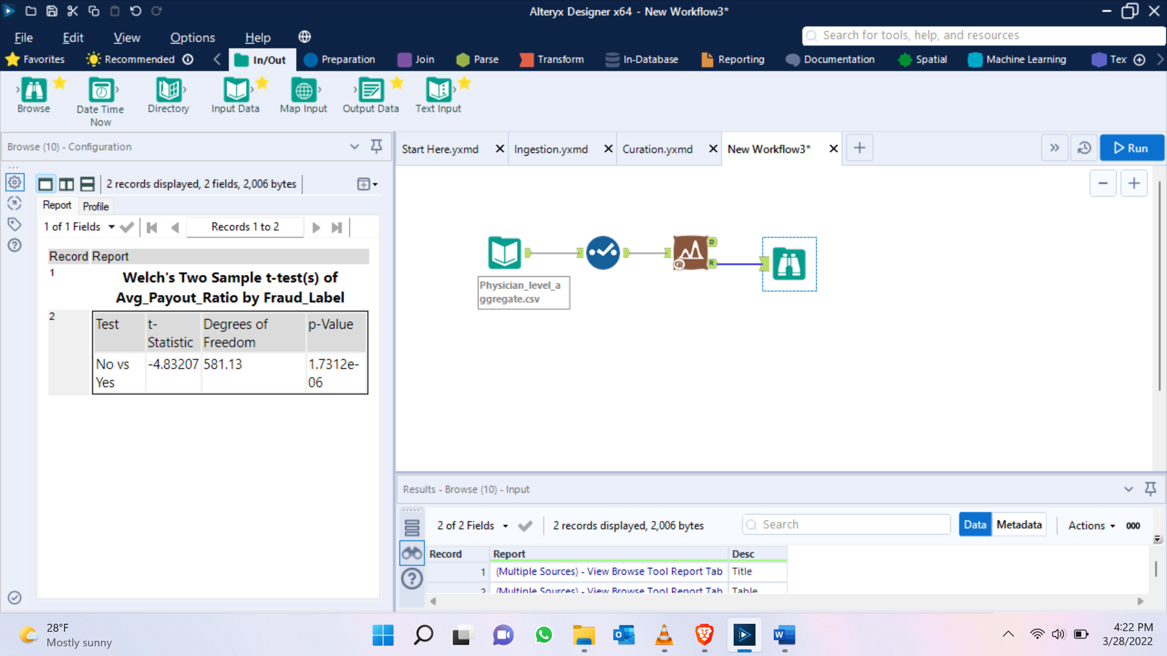
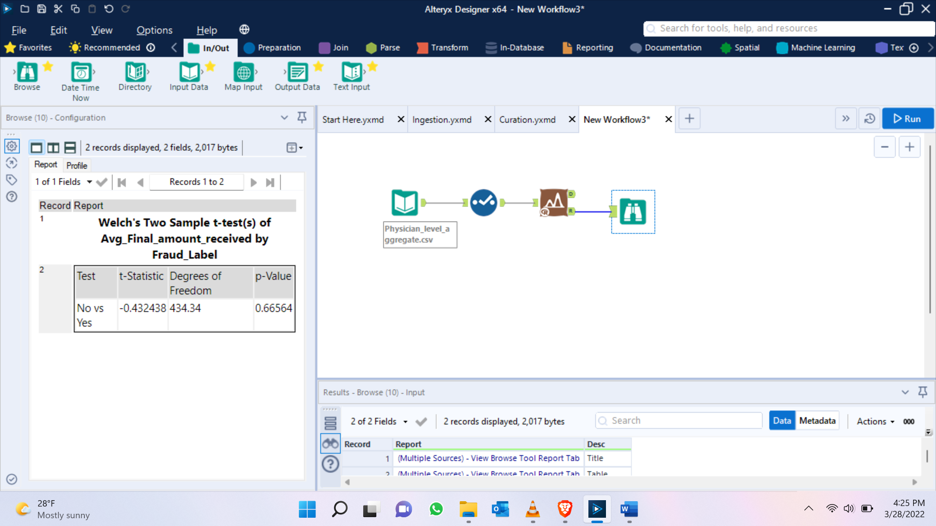
T-test

Slide 4


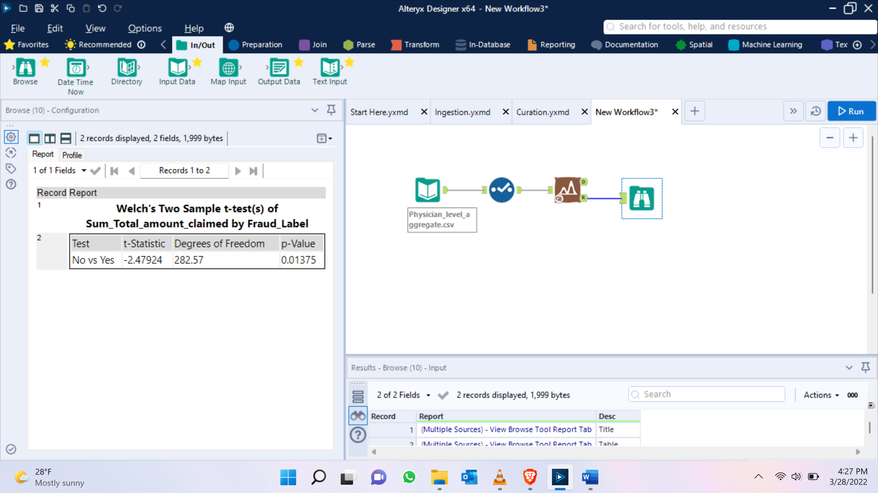
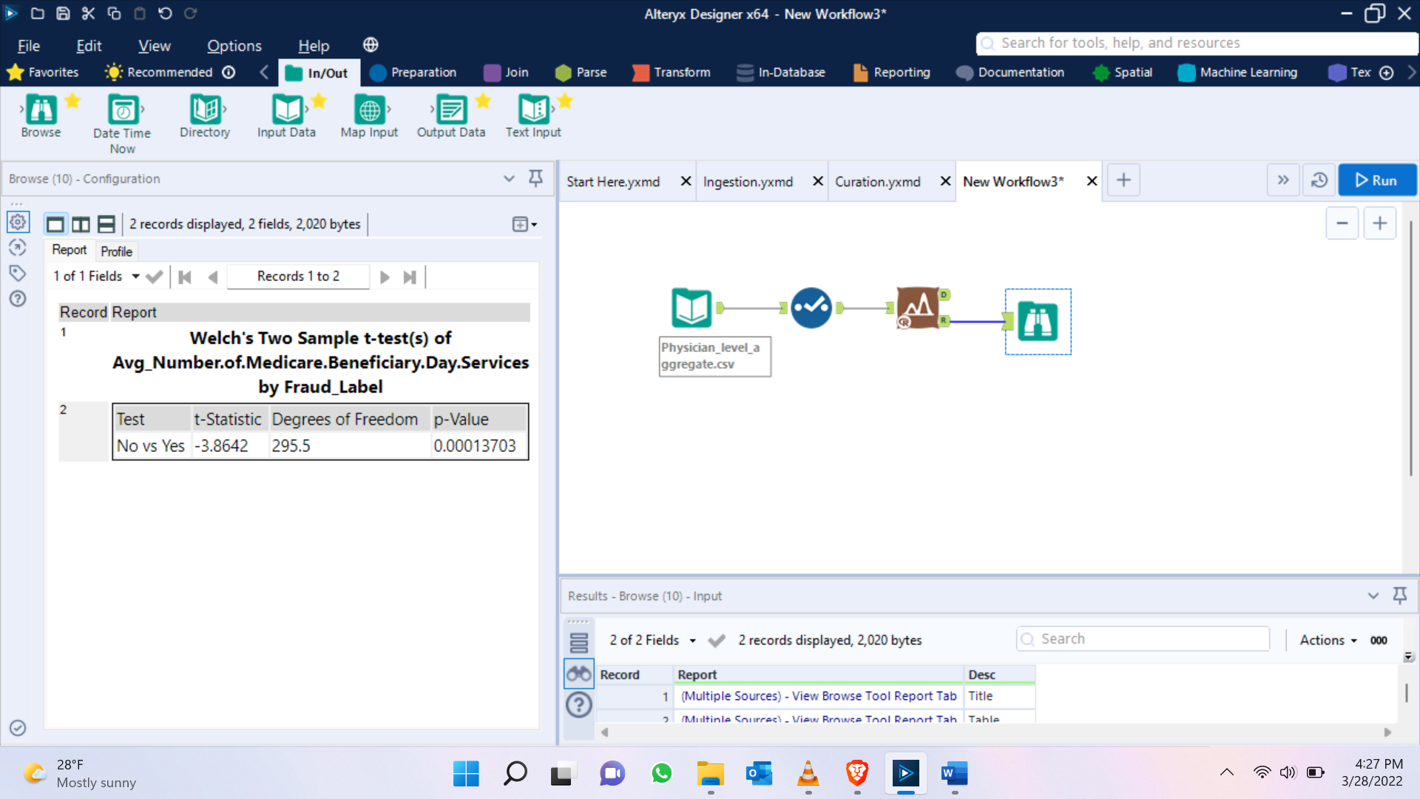
T-test

Slide 5


T-test
Based on the T-test, we will exclude Avg_Final_Amount_received and Avg_Access_Amount_Claimed from our model while keeping the rest of the variables in the model.

Slide 6
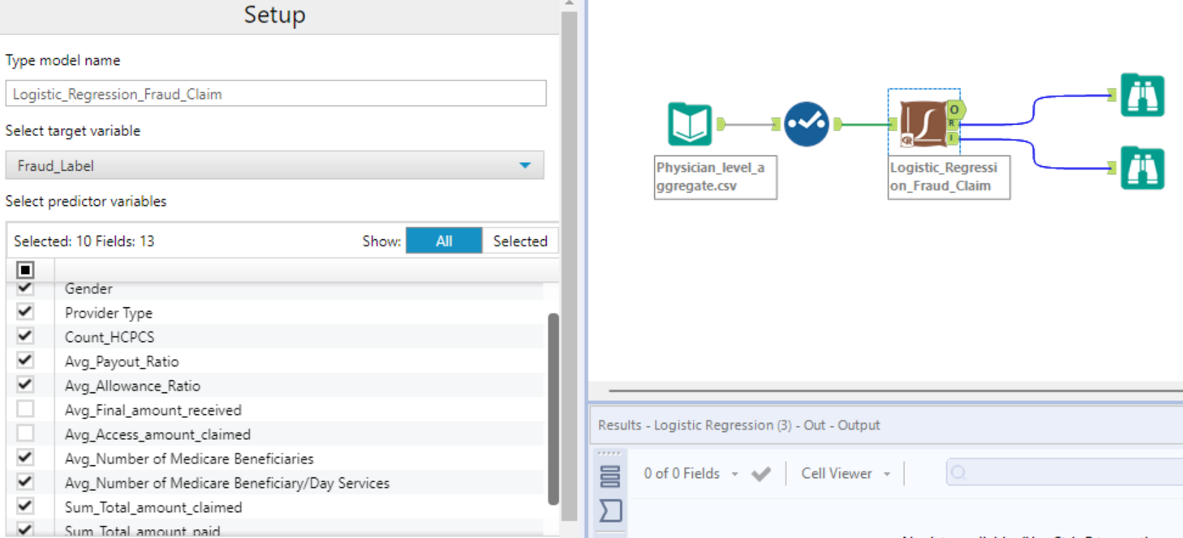
Logistic Regression

Slide 7
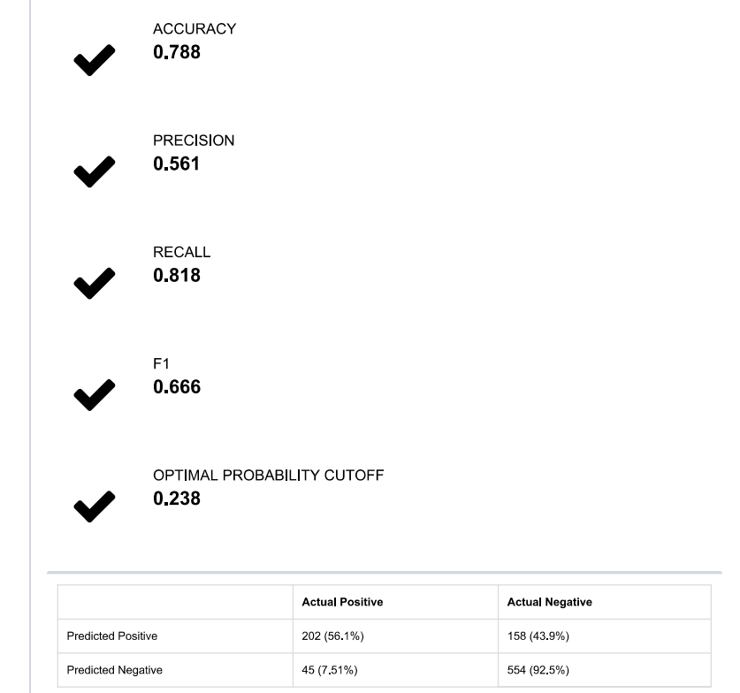
Logistic Regression Results

Slide 8
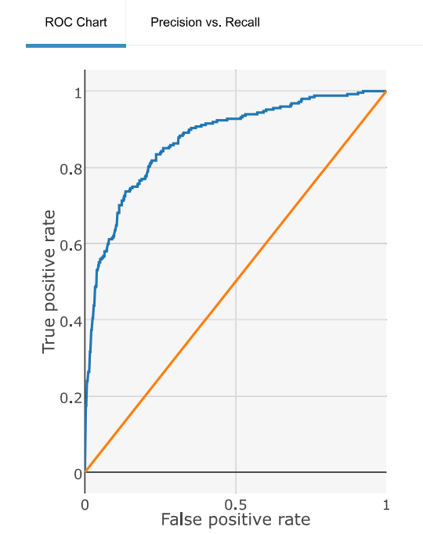
ROC Plot

Slide 9
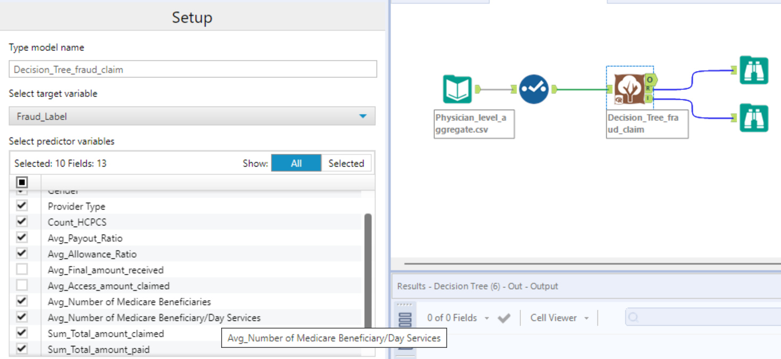
Decision Tree

Slide 10
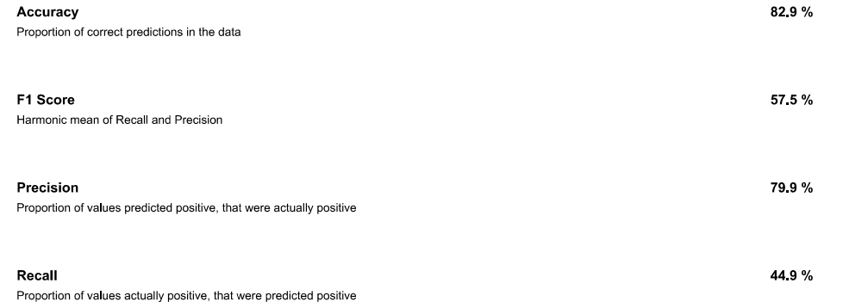
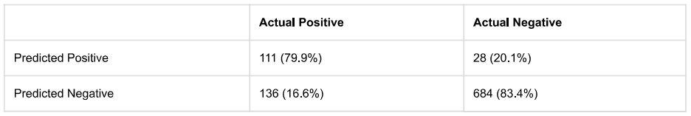
Decision Tree Results

Slide 11
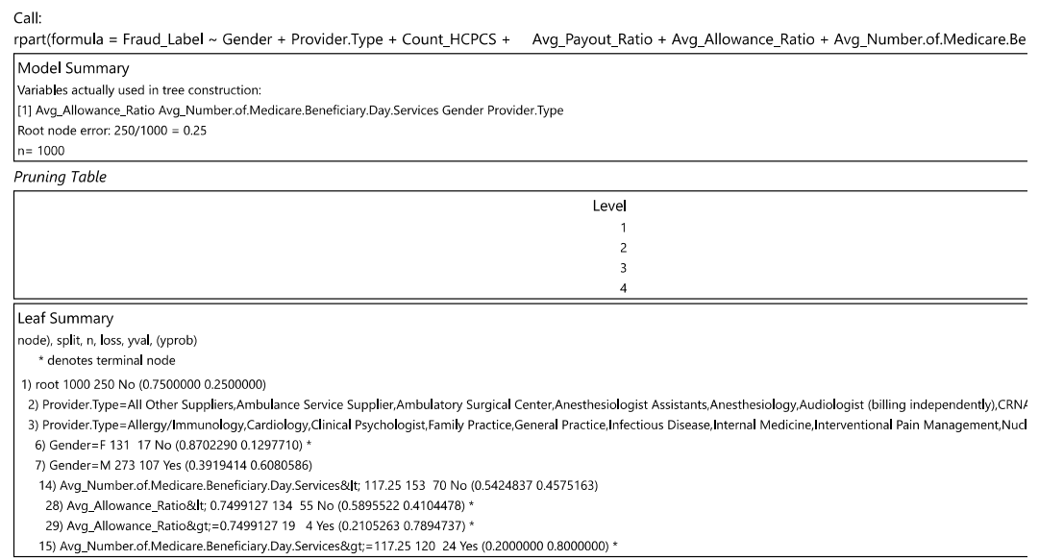
Decision Tree Summary

Slide 12
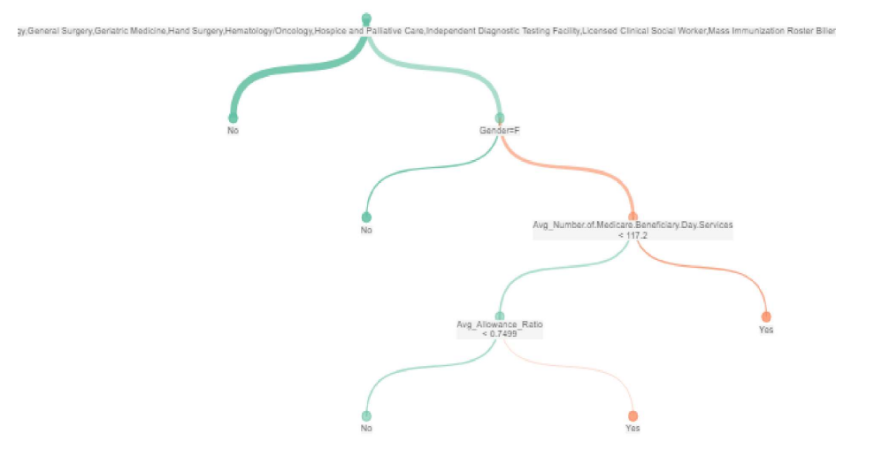
Decision Tree

